Slide 1
Advanced Reporting
Patrick Mathias
Lesson 7
DLMP Fall 2021

Slide 2
Goals
Build R Markdown reports using formatting outputs beyond standard document formats
Objectives
Format a flexdashboard to improve display of multiple plots
Convert a static plot into an interactive plot

Slide 3
Typical Data Science Pipeline
From R for Data Science (https://r4ds.had.co.nz/introduction.html)
Notes:
We refer to R for Data Science, a free text available online frequently
Provide a nice model for the typical process of analyzing data to communicate
Focus for this hour is the machinery that allows us to capture this whole process in a way that is reproducible and also can communicate to others

Slide 4
Refresher Quiz
You need to install 3 new packages you’ve never used before. What function do you run if you need to install the flexdashboard, plotly, and DT packages?

Slide 5
Refresher: Installing packages
Installing a package
Loading into your environment
install.packages(c(“flexdashboard”, “plotly”, “DT”))
library(flexdashboard)
library(plotly)
library(DT)
The flexdashboard and plotly packages were already installed in your Rstudio Cloud instance. To install them locally use install.packages.

Slide 6
From R Markdown to Quick and Painless Dashboards

Slide 7
Dashboards to drive improvement
Dashboards are a graphical interface to display key performance indicators or other metrics
Intended to represent multiple pieces of information at a glance

Slide 8
flexdashboard provides easy dashboard templates for reporting
Produces HTML file that can be opened on web browsers
Or deployed on existing web server
Provides row or column based layouts
Get started on your desktop by running: install.packages("flexdashboard")
https://rmarkdown.rstudio.com/flexdashboard/

Slide 9
flexdashboard output format
layout page by columns
define width
title for chart
delimits separate columns

Slide 13
Your Turn #1
Open “07 - Advanced Reporting.Rmd” to work with a draft COVID-19 flexdashboard and run the setup chunk. Knit the document to see the dashboard output.
The ”Test Volumes Over Time” plot could show additional information regarding positive tests. Add fill to your barplot to show the result field in addition to overall test volume by day. Run that code chunk to see the output.
Too much information is crunched on the right side. Change the layout from columns to a row orientation. The 2nd and 3rd plots (Turnaround Times and Cycle Thresholds) should appear on the 2nd row.

Slide 14
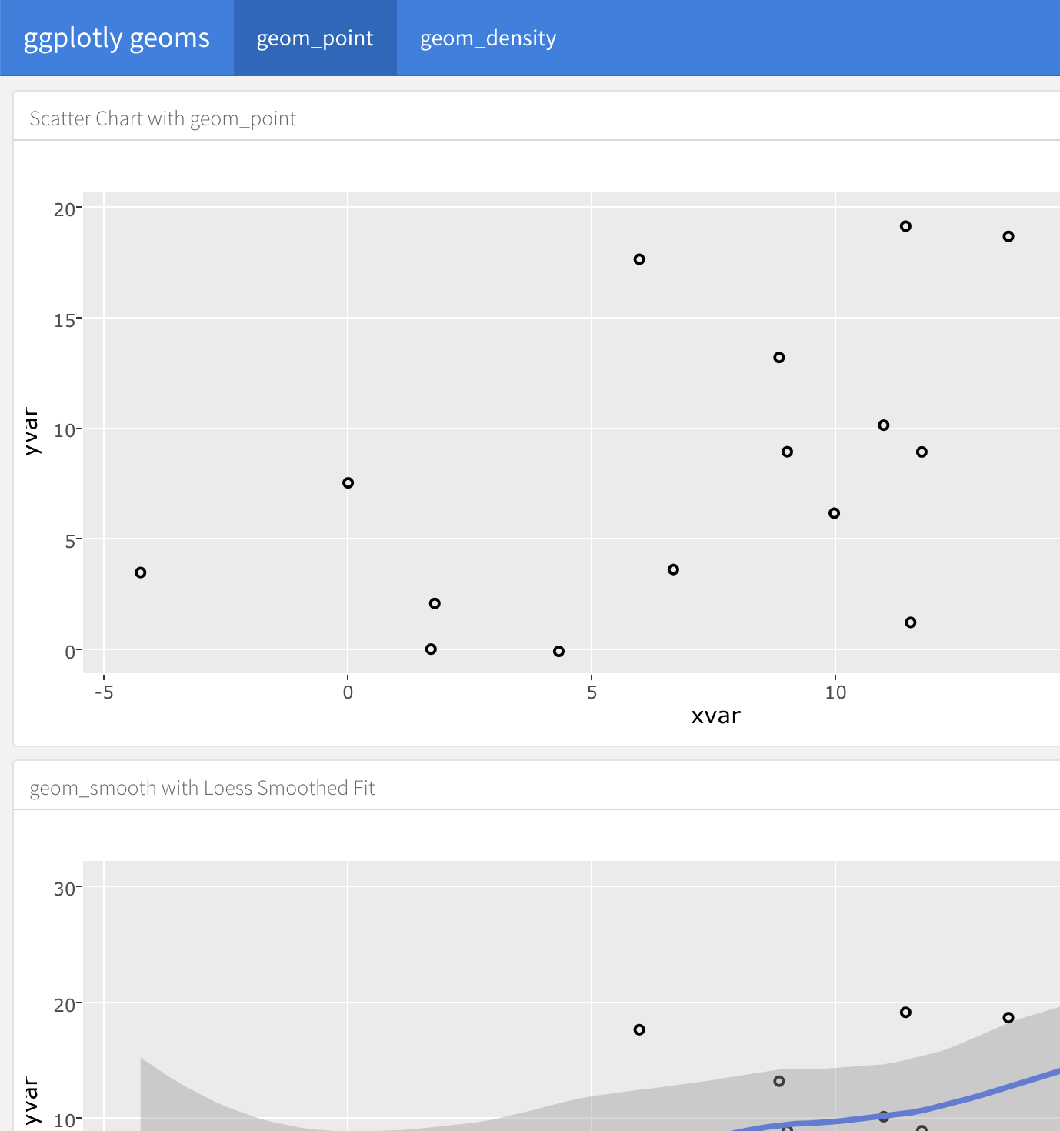
Customization
Multiple pages

Slide 15
Making plots interactive

Slide 16
htmlwidgets for R support interactive visuals
Packages using htmlwidgets use R code to call Javascript visualization libraries (http://www.htmlwidgets.org/)
Use one line of code to convert a static plot into an interactive one

Slide 17
Plotly package converts ggplot with a simple command
To use Plotly on your desktop install the plotly package using the following command:
install.packages(“plotly”)
Examples of visualizations at Plotly website: https://plotly.com/r/

Slide 18
Store plot as object and add one line to make interactive
plot_name <- ggplot(data = data_frame) +
geom_function(mapping = aes(mappings))
ggplotly(plot_name)

Slide 19
Your Turn #2
Load the plotly package in your setup chunk
Convert each of the plots into an interactive plot by storing the ggplot in an object and using the ggplotly() function.
Knit the dashboard and hover over the interactive plots.

Slide 20
Other options for interactive plots
Other interactive plot packages:
rbokeh
Highcharter
Time series graphs with dygraphs package
Maps with leaflet package

Slide 21
Making tables interactive

Slide 22
Interactive tables with one line
DataTables library quickly converts tables into interactive element
DT package in R – to install use:
install.packages(“DT”)
Use datatable() function on a data frame to allow:
Filter number of entries
Search entries
Sort by column

Slide 23
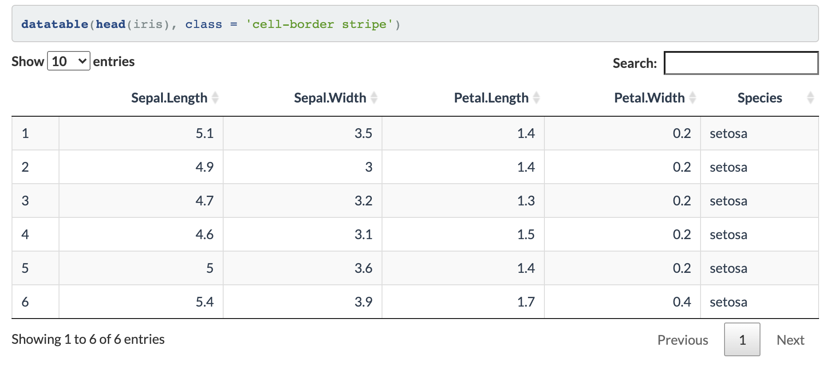
datatable example

Slide 24
Your Turn #3
We are going to replace one of our panels of content with an interactive table.
Load the DataTables package in your setup chunk
Rename the cycle threshold distribution panel to “Positive Result Details”. Use filter() to create a dataframe that only includes positive results.
Display an interactive table that includes the content from the positive result dataframe you created.
Knit the dashboard. Search “lannister” in the search box to confirm the interactive table is working.

Slide 25
What Else?

Slide 26
Standard Markdown Reporting Formats
HTML file - open with any web browser
PDF – requires LaTeX dependencies
install.packages('tinytex’)
tinytex::install_tinytex()
Word – default format for collaborating with those who aren’t familiar with R

Slide 27
Formats to go straight from code to slides
Multiple HTML formats create webpage that’s advanceable like slides
PDF presentation uses LaTeX in the background
Powerpoint produces simple slides

Slide 28
Output format
Each slide has its own header

Slide 29
R Markdown
This is an R Markdown presentation. Markdown is a simple formatting syntax for authoring HTML, PDF, and MS Word documents. For more details on using R Markdown see http://rmarkdown.rstudio.com.
When you click the Knit button a document will be generated that includes both content as well as the output of any embedded R code chunks within the document.
Example output slide

Slide 30
Slide with Bullets
Bullet 1
Bullet 2
Bullet 3
Example output slide

Slide 31
Slide with R Output
summary(cars)
## speed dist ## Min. : 4.0 Min. : 2.00 ## 1st Qu.:12.0 1st Qu.: 26.00 ## Median :15.0 Median : 36.00 ## Mean :15.4 Mean : 42.98 ## 3rd Qu.:19.0 3rd Qu.: 56.00 ## Max. :25.0 Max. :120.00
Example output slide

Slide 32
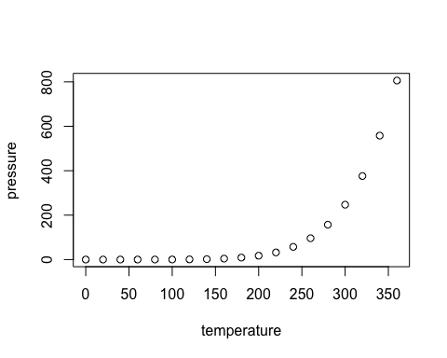
Slide with Plot
Example output slide

Slide 33
Books and longer documents also generated from R Markdown
Can generate printer ready books and ebooks
Supports LaTeX features such as equations
Generates blog formatted websites
https://github.com/rstudio/bookdown
https://bookdown.org/yihui/bookdown/
https://bookdown.org/yihui/blogdown/

Slide 34
Bonus Exercise

Slide 35
Your Turn #4
Customize your dashboard. Use any of the data available in your covid testing dataset to generate new plots or tables that provide insight into the underlying data.

Slide 36
Goals
Build R Markdown reports using formatting outputs beyond standard document formats
Objectives
Format a flexdashboard to improve display of multiple plots
Convert a static plot into an interactive plot

